Slide 1

UNIVERSAL HUMAN VALUES (UHV38)
By:
Dr. Roshan Zameer Ahmed
Assistant Professor, Dept. of ECE
M. S. Ramaiah Institute of Technology, Bengaluru – 54
Email: roshanahmed31@msrit.edu / roshanahmed31@gmail.com
Mobile: +91-9036875398 / 6361518037

Slide 2



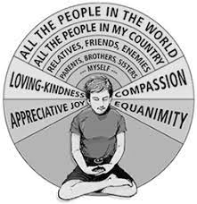


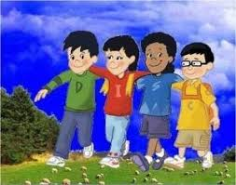
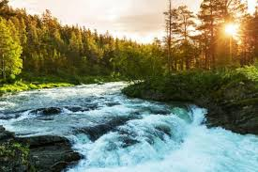
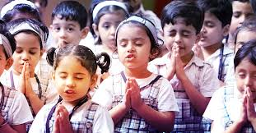

Slide 3


OVERVIEW
Unit 1:
Need, Basic Guidelines, and Process for Value Education
Unit 2:
Understanding Harmony in the Human Being
Unit 3:
Understanding Harmony in the Family and Society
Unit 4:
Understanding Harmony in the Nature and Existence
Unit 5:
Implications of the Holistic Understanding of Harmony on Professional Ethics

Slide 4
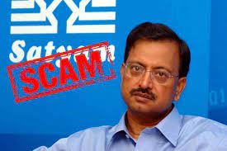
CASE STUDY:
1987 Mr. B. Ramalinga Raju Started Satyam Computers with his brother-in-law (Hyderabad-based IT Company)
Prior they had a Cotton business
1991-1992 Satyam Computers got listed in BSE
2001 Listed on New York Stock Exchange
It was India’s fastest-growing companies and had received many awards
Raju was focused more on Real-Estate in Hyderabad

Slide 5

CASE STUDY: SATYA NARAYAN NADELLA
Native of Anantpur (AP), born on 19th Aug 1967
Wife Anupama Nadella, 3 kids 2 daughters and a son
On dated 4th Feb 2014 he was made as CEO of Microsoft
He had keen interest in Engineering, so completed Bachelor’s in India and carried higher education at USA
He use to pursue studies and carry out job side by side
Got involved with Microsoft in various aspects
Draws more than 308 Crores (wrt to Indian Currency)
Today’s Microsoft shares have 7 times the value than previous comparison
Keep Hunger on (Curiosity towards new things) – Stagnant, Flow
Don’t Keep Confusion rather keep clarity
Family Conditions not good
Passion is different, profession is different
Be the strength not a leader

Slide 6
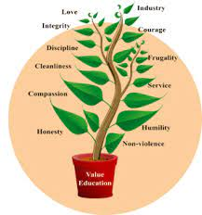
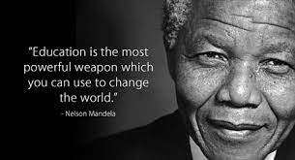
Importance of Value Based Education
Advantages:
Develop the children into people with strong character and values
Positive direction to students to shape their future
Teaches them best way to live
Students become more and more responsible and sensible
Understand the perspective of life in a better way
Students develop strong relationship with family and friends
Every parent wants to give the best education to children
Parents focus on extracurricular activities and value education along with academics
In current situation, huge crisis of moral values exists in society for which value-based education proves to be the solution

Slide 7

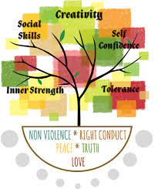
What are the fundamental values of Human beings?:
The five fundamental human values are : (1) Right Conduct (2) Peace (3) Truth (4) Love and (5) Non-violence
Values to right conduct:
Self-help skills: Care of possessions, diet, hygiene, modesty, posture, self reliance and tidy appearance
Social skills: Good behavior, good manners, good relationship, helpfulness, No wastage and good environment
Ethical skills: Code of conduct, courage, dependability, duty, efficiency, ingenuity, initiative, perseverance (continued effort), punctuality, resourcefulness, respect for all and responsibility.
Values to peace: Attention, calmness, concentration, contentment, dignity, discipline, equality, faithfulness, focus, gratitude, happiness, harmony, humility, inner silence, optimism, patience, reflection, satisfaction, self-acceptance, self-confidence, self control, self-discipline, self-esteem, self-respect, sense control, tolerance and understanding

Slide 8
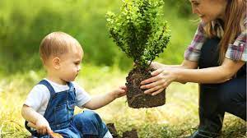
What are the fundamental values of Human beings?:
Values to Truth: Accuracy, curiosity, fairness, fearlessness, honesty, integrity (unity of thought, word and deed), intuition, justice, optimism, purity, quest for knowledge, reason, self-analysis, sincerity, spirit of enquiry, synthesis, trust, truthfulness and determination.
Values to Love: Acceptance, affection, care, compassion, consideration, dedication, devotion, empathy, forgiveness, friendship, generosity, gentleness, humanness, interdependence, kindness, patience, patriotism, reverence, sacrifice, sharing, sympathy, thoughtfulness, tolerance and trust.
Values to non-violence :
Psychological: Benevolence (kindness), compassion, concern for others, consideration, forgiveness, manners, happiness, loyalty, morality and universal love (accept everything)
Social: Appreciation of other cultures and religions, brotherhood, care of environment, citizenship, equality, harmlessness, national awareness, perseverance, respect for property, and social justice.

Slide 9


Need for Value Education:
All human beings aspire for a happy, fulfilling life
For a human being, there are two important questions pertaining to this:
• What is my aspiration? (What to do?)
• How to fulfil my aspiration? (How to do?)
The purpose of Value education is to facilitate the development of clarity on the aspiration and adequate competence to actualize it
For this, it is essential to understand what a happy, fulfilling and successful life is – what is really valuable for human being; what is our purpose as a human being? Understanding human aspiration, or what is really valuable for human being, is the value domain
It enables us to understand our aspirations and visualize our goals for a fulfilling life and indicates the direction for their fulfillment. In relation to these issues, it also helps to remove our confusions and contradictions. In that sense, VE addresses the issues related to ‘what to do?’.

Slide 10

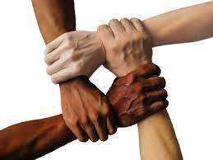
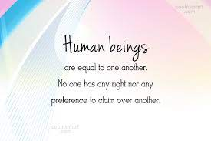

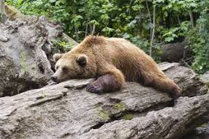
All Human Beings are Equal
Values and Skills are Complementary
Like Perseverance Compliments Passion, Individualism compliments Contribution
Values means importance / participation, and skills means qualities, training, and capabilities
Ex:
I want to lead a healthy life
Only wishing for good health will not make the body fit and healthy without having understood the meaning of health
So, learn skills to achieve the goal of health, food to be consumed, physical workout to be designed etc.
Without meaning of good health, health cannot be achieved and it is necessary to use the goal to achieve it
We all serve each other. No one is the master
You should never consider yourself a master to rule others
No one is superior to anyone and no one is inferior to anyone
We should always raise our voice against any injustice

Slide 11
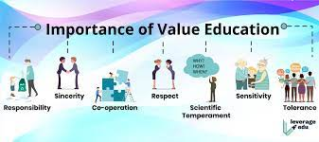
Guidelines for Value Education:
Universal:
It has to be universally applicable to all human beings for all time and all places
This implies that values should not change according to sect, creed, nationality, gender, etc.
Rational:
It has to appeal to reasoning; and not be based on dogmas or blind beliefs
It has to be open to address the related questions
It cannot be a set of sermons or do’s and don’ts.
Natural and Verifiable:
It has to be 'naturally acceptable' to the human being and there needs to be every provision in nature for its fulfillment
It needs to be experientially verifiable, and not based on dogmas (principles), beliefs or assumptions
It is not merely an intellectual exercise or information transfer
All Encompassing:
It needs to cover all dimensions (thought, behavior, work and understanding) and levels (individual, family, society and nature/existence) of human life
Leading to Harmony:
It ultimately needs to promote harmony within the individual, among human beings and with the entire nature

Slide 12
CASE STUDY: ON MORALS & BAD MANAGEMENT
453 Crore Loan Waved OFF - $45 Billion in 2007 to $1.9 Billion in 2019 – Chief Financer Officer
$54 Billion – 10th Richest Person in the World (352 Crores) – Backend – Decision Maker
2002 Dhirubai Ambani Expired; 2006 Kokila Ben Split the 90,000 Crore Business between the two
RELIANCE BIG ENTERTAINMENT
RELIANCE COMMUNICATIONS
Poor Management Skills
Overambition
Wrong Decision Making
Not Understanding the Market
Do not Shift focus rapidly

Slide 13
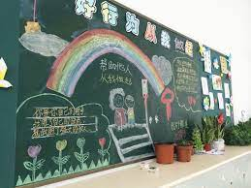


Content of Value Education
The value of an entity is its participation in the larger order of which it is a part: The context is always the larger order. Value has to do with the participation of a unit in the larger order Ex: Classroom & Chalk
The value or role of a human being is its participation in the larger order: E.g. Living with the other human being is to ensure the feeling of respect in the relationship
The value of human being is to ensure mutual fulfilment in the larger order: i.e. in the entire nature/existence, but starting from within themselves, then extending in their family and in the society
• It has to cover all dimensions of human being – thought, behavior, work and realization.
• It has to cover all levels of human living – individual, family, society, nature and existence.
Content of Value Education has to be understood by human being, in terms of human aspirations, happiness; understand the goal of human life comprehensively; understand the other entities in nature, the harmony in the nature/existence and finally the role of human being in this nature/existence

Slide 14


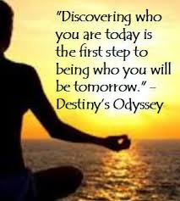
Self- Exploration
It is knowing and then bridging the gap between ‘what you are’ and ‘what you really want to be
It is focusing attention on our self, our present beliefs, and knowing what is naturally acceptable to us
In this process, we slowly start discovering that there is something innate, invariant and universal in all human beings
Becoming aware of our natural acceptance enables us to look at our confusions and contradictions within and resolve them
We discover the definitiveness of human conduct and human character, which enables us to be definite in thought, behavior and work
Self exploration helps us to be in harmony with ourself and with entire existence
The main focus of self exploration is myself- the human being
What is the goal of human life ? and How to fulfill it ?
(Class Interaction)

Slide 15

Self-Exploration
Self exploration is the process to find out what is valuable to me by investigating within myself
What is right for me and true for me has to be judged within myself
Once we start paying attention towards investigating into our present beliefs and aspirations, we get to know whether our aspirations and what we really want to be (i.e. what is naturally acceptable to us) are one and the same or not. If they are the same, then it’s no problem
But if the two are different, it means that we are leading a life against our natural acceptance. Such a life cannot bring us happiness
Self exploration is a process of discovering that there is something innate, invariant and universal in all human beings. This enables us to look at the confusions and contradictions within us and resolve them by becoming aware of our natural acceptance. Once we start observing, we can achieve harmony at all levels of our living
Find Answers for the following questions:
What is my Desire/ Goal? What do I really want in life, or what is the goal of human life?
What is my program for fulfilling my aspirations? How to fulfil it? What is the program to actualize the above?

Slide 16
Self-Exploration – Purpose
Self exploration helps us to identify our innateness (Svatva: Derived from the mind) and move towards Self-Organization (Swantantrata: Being in harmony with oneself) and Self-Expression (Swarajya: Being in harmony with others)
It is a process of dialogue between ‘what you are’ and ‘what you really want to be’.
It is a process of self evolution through self-investigation.
It is a process of knowing oneself and through that, knowing the entire existence
It is a process of recognizing one’s relationship with every unit in existence and fulfilling it
It is a process of knowing human conduct, human character and living accordingly
It is a process of being in harmony with oneself and in harmony with entire existence
Steps: How do you understand yourself
In real life perfection does not exist, life is actually imperfect
When curiosity exist we go more deep. (ex: how can I make relationship more perfect, why people cheat me, how do I control my diet)
EGO doesn’t mean arrogance, it is just how I am. What sort of thoughts, what sort of contributions, stress, conflicts. It deals with how I connect with the other person
Don’t feel lonely the Universe is inside you
You are not a drop in the ocean, Ur the ocean in a drop
Get out of illusion and see the reality
Exploring our svatva at different levels of our living helps us in getting rid of our preconceived notions, our dilemmas, contradictions and compulsions, either external or internal. The more, we attain Swatantra or the self- organized state, the more we can live in harmony with others and we can also help others attain this state. This leads to our participation in swarajya.

Slide 17
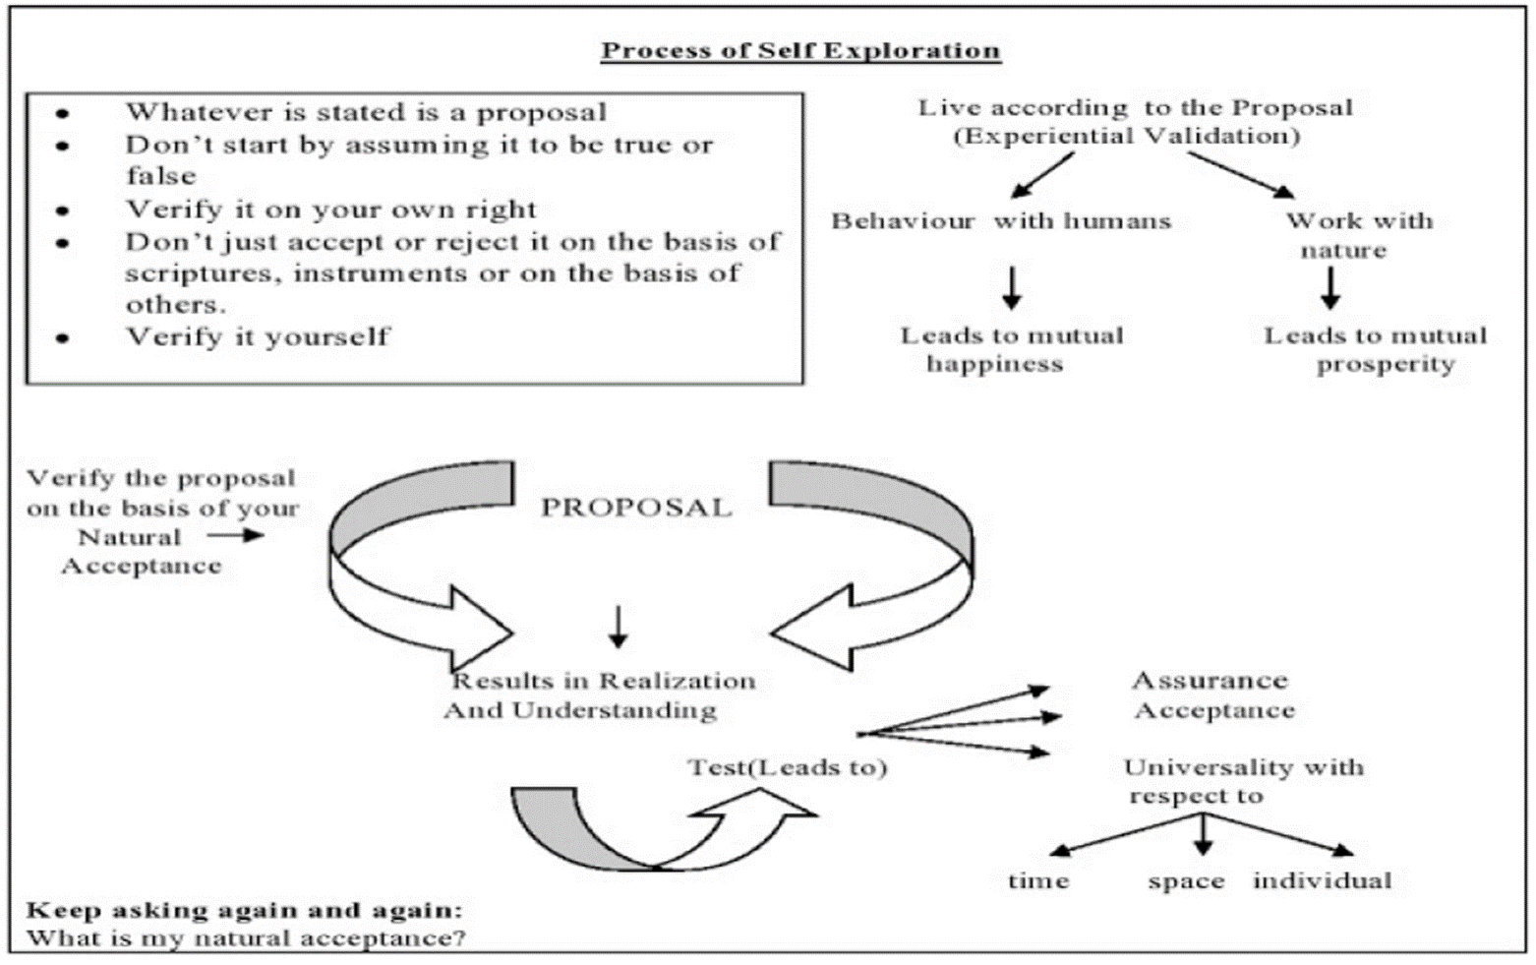
Self-Exploration - Process

Slide 18
Self-Exploration – Process
The following two steps are involved in the process of Self-Exploration:
Firstly, verify the proposal on the basis of your natural acceptance
Secondly, live according to the proposal to validate it experientially
Natural Acceptance: It is the process of seeing and observing everything attentively and then using your inner conscience to get the answer from within. It is a way to bring out the goodness in everything naturally. It helps us to learn everything that is good from others and absorb it in our own way, but without changing our identity
It does not change with time/age
It doesn’t depend on place
It does not depend on our beliefs or past conditioning
It is always there within us
It is the same for all of us
Experimental Validation:
Experimental validation is a process that infuses direct experience with the learning environment and content
Most of what we know about ourself is not only through our own opinion of ourself but also because of how others view us
When/what we already believe to be true of us is validated by some situations, phenomena or outcomes. We may term it as experimental validation

Slide 19


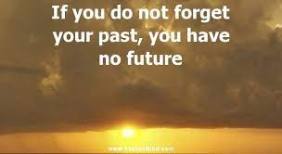

How can we verify proposals on the basis of our natural acceptance? Explain with example.
(Or) What do you mean by your natural acceptance? Illustrate with examples. Is it innate, universal and invariant with time? Explain
Natural Acceptance: It is the process of seeing and observing everything attentively and then using your inner conscience to get the answer from within. It is a way to bring out the goodness in everything naturally. It helps us to learn everything that is good from others and absorb it in our own way, but without changing our identity.
a) Natural acceptance does not change with time/age: It remains invariant with time. Ex: our natural acceptance for trust and respect does not change with age
b) It does not depend on the place: Whatever we have naturally accepted in our life does not change with our age, place or time. Ex: our desire for respect doesn’t change with age or with a change in our place
c) It does not depend on our beliefs or past conditionings: No matter how deep our beliefs or past conditionings, as long as we keep investigating deep into ourselves, the answers will always be the same. Natural acceptance does not get influenced by our beliefs or past conditionings. Ex: we may believe that money is the most important thing in life. But looking deep down in our heart , we know that money alone cannot keep us happy

Slide 20
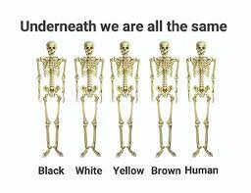
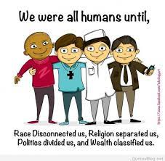
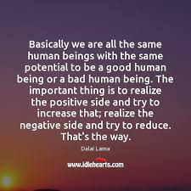
d)This natural acceptance is always there within us: Natural acceptance is always present within us, it always tells us what is right
e) Natural acceptance is the same for all of us: Each one of us have our own lifestyle, beliefs, preconditioning, etc. But deep inside our minds, the purpose of all human desires, success and achievements are based on common goals like the need to be happy, need to be respected and cared for, need to be prosperous etc. So the basic natural acceptance remains the same for all the human beings.
All human beings can lead a happy and prosperous life as long as they follow their natural acceptance
All miseries begin only when we start going against our Natural acceptance

Slide 21
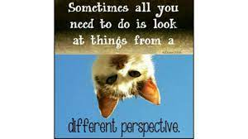
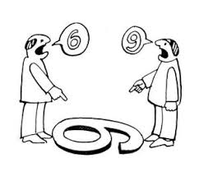

What are pre-conditionings? What is their source? Do you feel that you have some preconditioning? How do you evaluate them?
Preconditioning means the condition developed by beliefs (manyatas)
Often we have our own assumptions about something on the basis of our prevailing notions. They come from what we read, see hear, what our parents tell us, our friends talk about what the magazines talk of, what we see on the TV etc. Most of our desires, thoughts and selections are based on these pre-conditionings
We do not verify the desires in our own right. As a result, we are not clear about what we will get out of fulfilment of that desire
Because of this, we often end up spending an entire lifetime accumulating desires that are not ours, and in running about trying to fulfil them. As a result, our desires, thoughts and selections are always in conflict. Since the desires are in conflict, the thoughts they give rise to, are also in conflict and in turn, the selection from the thoughts are also in conflicts leading to dissatisfaction and unhappiness.
Ex: Most of us believe that money and position bring us respect and make us happy. We start living by this pre-conditioning and work hard to achieve it. We also involve ourselves in all those activities which are needed to achieve it. During this process, we often experience disharmony within ourselves and with others. With unhappiness within, we also make others unhappy.
However, once we start exploring deep into ourselves on the basis of our natural acceptance, we realise the difference between what we are and what we really want to be. This realization leads to the right understanding which paves way to a harmonious living within ourselves, our family, our society and also with nature.

Slide 22
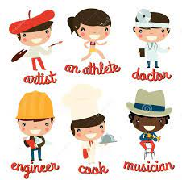
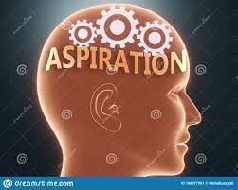
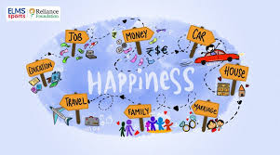
“I want to be an
In the above cases, what is the basic aspiration? Justify your answer.
Aspirations are the goals, ambitions or desires that a person often dreams to possess or achieve
Aspirations are future-oriented and are driven by conscious and unconscious motivations. They are indicative of an individual or group’s commitments towards a particular end point
Some aspirations come about with a little influence from others, while some others stem from the strong persuasion of other people or situations
Individuals may have short, medium and long-term aspirations and these vary in importance with respect to both the individual and the others
Not all aspirations are in the interests of others and some individuals’ aspirations may even provoke harm or offence
While some individuals aspire for a better life, some others might strive for specific transformative social changes

Slide 23


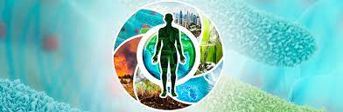



ASPIRATIONS:
The most common aspirations of all human beings are centered around health, family, philanthropy and personal development
Some common aspirations include making a difference in life, personal happiness, job satisfaction, acquiring status and wealth etc.
In all the above cases, the basic aspiration is to ultimately lead a happy life. The aspirations to become a doctor, a film star, to do research in astronomy stem out of the interest that the person has in those fields. Success in these would make them feel happy in their lives
Similarly the aspiration to serve the society means the person derives happiness in doing philanthropic deeds. Earning a lot of money and fame means the person want to lead a happy life with respect and comforts in the society
Hence we can say that the basic aspiration underlying all the above aspirations is to attain continuous happiness

Slide 24

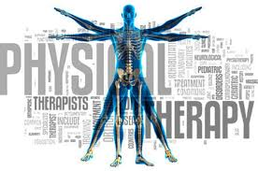
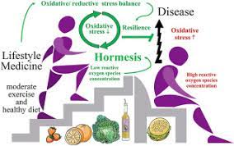
Continuous Happiness and Prosperity - A look at basic Human Aspirations
All human beings basically aspire for/ want the following in their life:
Continuous Happiness
Prosperity
If all of us happen to prepare a list of our aspirations, we will find that all our aspirations have an underlying basic desire – the basic aspiration to be happy
Through his life, every human being is continuously trying to do things that make him/her happy. In other words, we always look for continuous happiness in our life
In addition to happiness, we also aspire for adequate fulfillment of our bodily needs i.e. the need for physical facilities
These Physical Facilities are the material things we use in order to fulfill the needs of our body
Having enough physical facilities gives us a feeling of prosperity. We want to have a continuity of this feeling too. Hence prosperity is another basic aspiration of every human being

Slide 25



Exploring Happiness and Prosperity:
Happiness:
Happiness may be defined as being in harmony/ synergy in the states/ situations that we live in
Happiness is being in a state of liking. Unhappiness is a lack of this synergy or harmony. To be in a state of disliking is unhappiness
Happy situations comprise of feelings such as trust, respect, confidence etc. All these feelings carry an element of harmony in them. Hence they make us feel relaxed and happy.
On the other hand, feelings like failure, disrespect, lack of confidence, doubt etc. lack the element of harmony and hence make us unhappy.
Prosperity: It is the feeling of having more physical facilities than required. Prosperity creates a desire to share what one possesses. However, since the need for physical facilities is limitless, the feeling of prosperity cannot be assured.
Wealth: Wealth is a physical thing. It means having money, or having a lot of physical facilities, or having both.
Prosperity Vs Wealth: Wealth means possessing more number of physical things while Prosperity is a feeling of possessing more than required physical facilities.

Slide 26

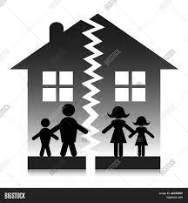

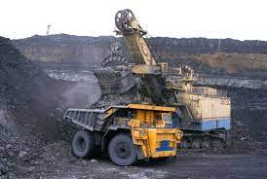
Following are the possibilities:
Case 1: A person may not possess required physical facilities, so he may not feel prosperous
Case 2: A person may accumulate more and more wealth but still he may be deprived of the feeling of prosperity
Case 3: A person may have required wealth and feel prosperous
The false notions of happiness and Prosperity have affected human living at all four levels:
At the level of Individual: Problems of depression, psychological disorders, suicides, stress, insecurity, psycho-somatic diseases, loneliness etc.
At the level of family: Breaking of Joint families, mistrust, conflict between older and younger generations, insecurity in relationships, divorce, dowry tortures, family feuds, wasteful expenditures in family functions etc.
At the level of Society: Terrorism, naxalism, communism, casteism, racial, ethnic struggles, wars between nations, genocide, nuclear genetic warfare
At the level of Nature: Global Warming, pollution, depletion of mineral resources, deforestation, loss of soil fertility

Slide 27
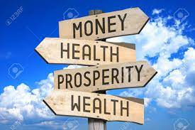

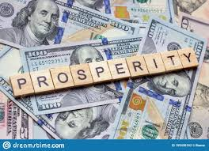
Difference between Prosperity and Wealth
PARAMETERS | PROSPERITY | WEALTH
Definition | It refers to a state of success as well as financial prospects | It refers to a large amount of money or valuable possession
Material Gain | It can be used to speak of material gain as well as other prospects | It is solely used to speak of material gain
Success | It can be used to speak of success | It cannot be used to speak of success
Happiness | It can be used to speak of happiness | It cannot be used to speak of happiness
Health | It can be used to speak of health | It cannot be used to speak of health

Slide 28
Sadhan Viheen Dukhi Daridra (SVDD):
Refers to the condition of a person who does not have the means to fulfill his materialistic desires.
Those that do not have physical facilities/ wealth and feel unhappy and deprived (Materially Deficient, Unhappy and Deprived)
Sadhan Sampann Dukhi Daridra (SSDD):
Money is not all that matters
State of person in which he has all the means to acquire materialistic requirements of life, but still something is lacking in life (Materially Affluent, Unhappy and Deprived)
Sadhan Sampann Sukhi Samriddha (SSSS):
Having physical facilities and feeling happy and prosperous
Materially Adequate, Happy and Prosperous.
Presently, as we look around, we find most of the people in the above two categories called SVDD and SSDD, while the natural acceptance of all human beings is to be in the category of SSSS.
Materialistic Desires include: Food, Shelter, Clothing etc.
Non-Materialistic Desires include: Respect, Trust, Happiness, Care.

Slide 29
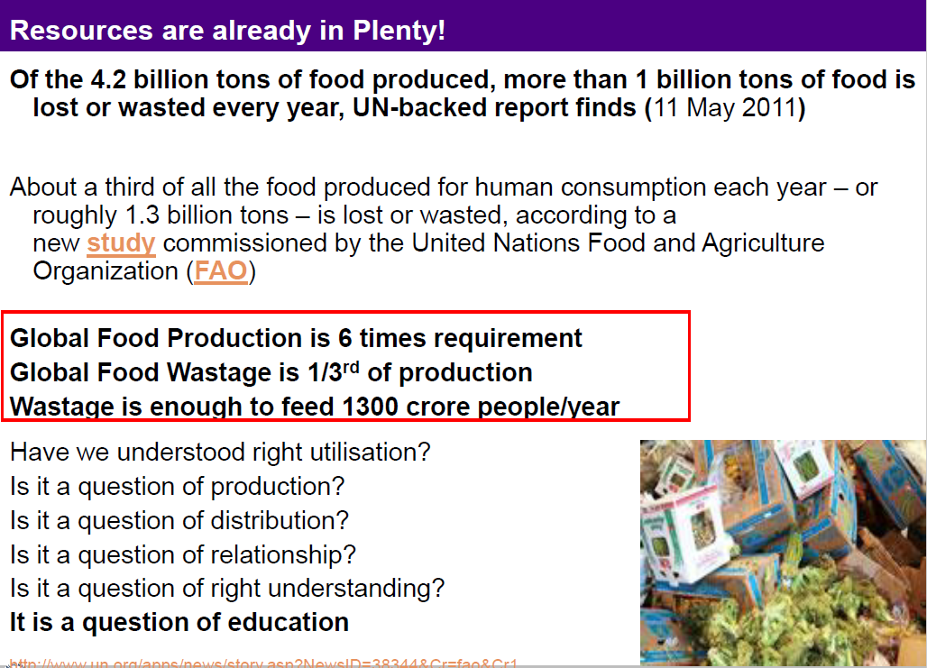
Example of misuse of Resources
.

Slide 30
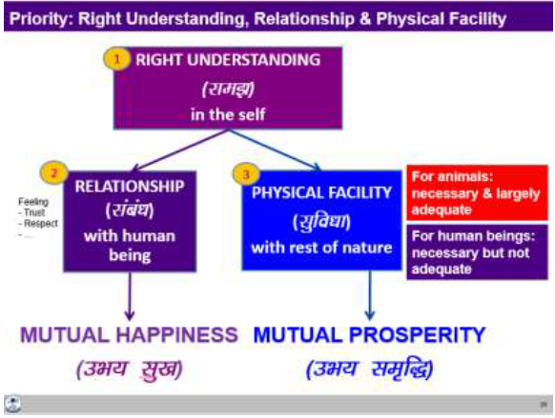
4. Right understanding, Relationship and Physical Facilities- the basic requirements for fulfillment of aspirations of every human being with their correct priority
What are the requirements to fulfil basic human aspirations? (OR) What is the program to fulfil the basic human aspirations? Explain (OR) Explain the basic requirements to fulfil human aspirations. Give the correct priority among them. (OR) Three things are needed in order to fulfill basic human aspirations–right understanding, right relationships and physical facilities. Explain meaning of each one of these.

Slide 31
Our basic aspirations are happiness (mutual fulfilment) and prosperity (mutual prosperity). Happiness is ensured by the relationships with other human beings and prosperity is ensured by working on physical facilities.
Right Understanding: This refers to higher order human skills – the need to learn and utilize our intelligence most effectively. It helps us to decide how we work for physical facilities and maintain feelings of different relationship with others. It is one of the major tools for fulfilment of our aspirations, which basically need the transformation from animal consciousness to human consciousness.
Good Relationships: This refers to the interpersonal relationships that a person builds in his or her life – at home, at the workplace and in society.
Physical Facilities: This includes the physiological needs of individuals and indicates the necessities as well as the comforts of life. It means the feeling of having or being able to have more physical facilities than is needed.
In order to resolve the issues in human relationships, we need to understand them first, and this would come from ‘right understanding of relationship’. Similarly in order to be prosperous and to enrich nature, we need to have the ‘right understanding’. The ‘right understanding’ will enable us to work out our requirements for physical facilities and hence correctly distinguish the difference between wealth and prosperity. With nature as well, we need to understand the harmony in nature, and how we can complement this harmony.

Slide 32
Ex: Sitting in a hot room… we are uncomfortable & unhappy
Q: Does an AC help us resolve our discomfort & unhappiness?
An AC does help resolve the physical discomfort
However, it is not clear that the AC provides any relief from unhappiness
?
RIGHT UNDERSTANDING
in the self
?
1
RELATIONSHIP
with human being
AIR CONDITIONER
Notes:
Gratitude for PF << Gratitude for Feeling in Relationship << Gratitude for RU
Parents feel that they invested the whole life for the children (providing PF)
If they have not paid attention to RF & RU, then the children may not have gratitude for the parents
Typically the father provides the PF, the mother provides PF and feeling, so children are more attached to the mothers

Slide 33
Ex: Sitting in an AC room… with someone we are opposed to…
Q: Is the feeling of opposition naturally acceptable? Or do we want to get rid of the feeling of opposition, to resolve the relationship?
We can see that an AC has no impact in resolving relationship
Physical facility does not have any lasting impact in relationship. E.g. A gift can atmost distract attention for some time – it is not a solution
Right understanding about relationship and right feeling in oneself is required for resolving the relationship
?
RIGHT UNDERSTANDING
in the self
?
1
OPPOSITION
IN
RELATIONSHIP
AIR CONDITIONER
Notes:
You are sitting with someone with whom you have a feeling of opposition – will you be happy / unhappy?
Many people share that when they are in office, they are excellent performers. But when they go home, they do not get the same response from the family - why? Because at home, feeling in relationship is still important.

Slide 34
Ex: Sitting alone in an AC room… thinking about one we oppose...
Q: Does the AC help us resolve the contradiction in our thoughts?
We can see that an AC has no impact in resolving contradiction in thoughts
Right understanding is required to resolve contradiction in thoughts
?
CONTRADICTION
IN
THOUGHTS
?
1
RELATIONSHIP
with human beings
AIR CONDITIONER
Notes:
You were sitting with someone with whom you have a feeling of opposition.
Now that person has left, but you are still thinking about that relationship (there is contradiction in your thoughts) – will you be happy / unhappy?

Slide 35
“Physical facilities are necessary and complete for animals, while they are necessary but not complete for humans.” Comment. (Or) Explain how physical facilities are necessary but not complete for humans while they are complete for animals. (Or) Physical facilities are necessary but not complete for human being. Do you agree with this statement? Support your answer with reasons and examples.
Physical facilities are necessary and complete for animals, while they are necessary but not complete for humans. It is easy to verify.
For Animals: Animals need physical things to survive, mainly to take care of their body. For example; cow will look for food when it is hungry. Once it gets the grass or fodder. It eats it, sits around to chew at leisure. Hence, we can say that as long as animals have physical things, they are largely fine. They don’t desire other things like knowledge or a peaceful animal society or getting a good MBA.
For Humans: While physical facilities are necessary for human beings, they are not complete by themselves to fulfill our needs. Our needs are more than just physical facilities. We all have other needs, other plans, perhaps we think of going to a movie or reading a book, or go to college, or watch some TV, or spend time with family and friends….. this list is endless. Thus it is easy to see that while physical facilities are necessary for us human beings, they are not complete by themselves to fulfill our needs.
Hence we can say that for animals – “Physical facilities are necessary and complete.”
For humans “Physical facilities are necessary but not complete.”

Slide 36
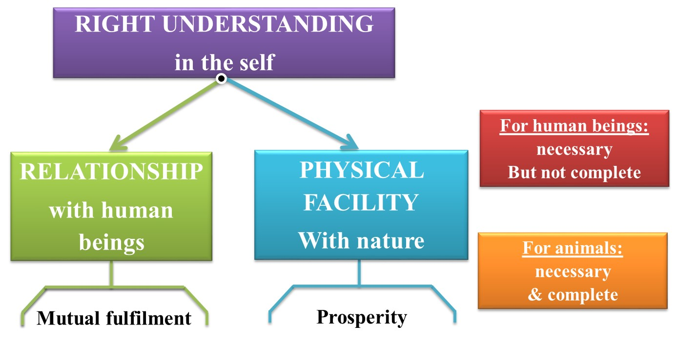

Slide 37
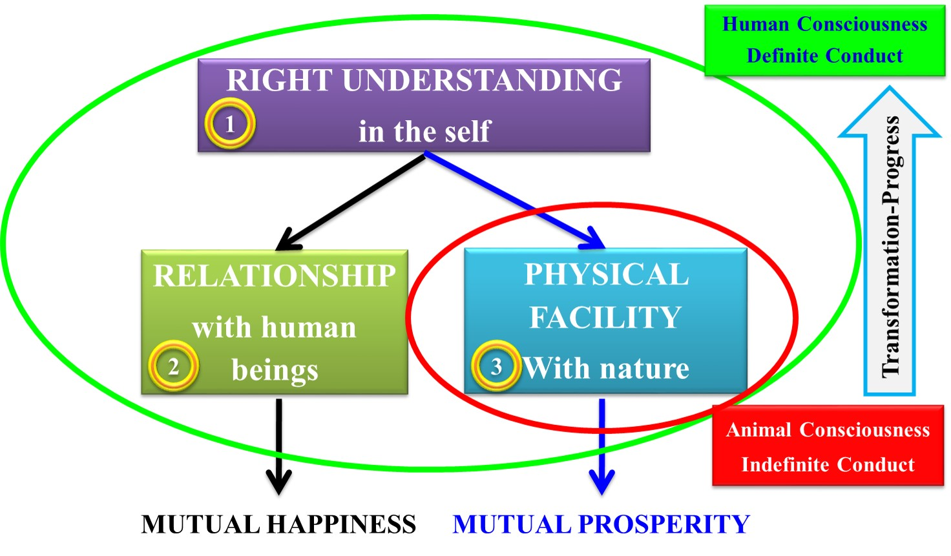
What do you mean by animal and human consciousness? Explain with the help of a diagram. Or Distinguish between ‘human consciousness’ and ‘animal consciousness’. How “shiksha and sanskar” are helpful in raising man to “human consciousness” level. Or What is the difference between animal consciousness and human consciousness? How does the transformation take place in a human being?
Giving all priorities to physical facilities only, or to live solely on the basis of physical facilities, may be termed as ‘Animal Consciousness’. Living with all three: Right understanding, Relationship and Physical facilities is called ‘Human Consciousness’.

Slide 38
From the diagram we can say that:
• For animal, physical facility is necessary as well as complete – whereas for human beings it is necessary but not complete.
• Working only for physical facilities is living with Animal Consciousness.
• Working for right understanding as the first priority followed by relationship and physical facilities implies living with Human Consciousness.
• There is a need for transformation from Animal Consciousness to Human Consciousness. It can be accomplished only by working for right understanding as the first priority.
• This transformation from Animal Consciousness to Human Consciousness forms the basis for human values and values based living.
The content of education is the understanding of harmony at all the four levels of our existence –from myself to the entire existence. Right living or sanskar refers to the ability to live in harmony at all the four levels of living. This dimension of society works to ensure ‘right understanding’ and ‘right feelings’ in individual. Or all-encompassing solution called samadhan in every individual and ensures that our succeeding generation have both the content and the environment available to work towards achieving their goal of continuous happiness and prosperity.

Slide 39
5. Understanding Happiness and Prosperity correctly- A critical appraisal of the current scenario
Critically examine the prevailing notions of happiness in the society and their consequences. Or What is prosperity? Is it different from happiness? Or What is the outcome when we try to identify relationship based on the exchange of physical facilities?
Happiness may be defined as being in harmony/synergy in the state/ situation that I live in. “A state or situation in which I live, if there is harmony in it then I like to be in that state / situation. The state of liking is happiness.” Whereas, prosperity is the “feeling of having or making available more than required physical facilities”.
In the current scenario, we are generally trying to achieve happiness and prosperity by maximizing accumulation and consumption of physical facilities. This is an attempt to achieve happiness through pleasant sensory interactions. The physical facilities are not seen in terms of fulfilling bodily needs but as a means of maximizing happiness.
This has resulted in wrong assessment of wants for physical facilities as being unlimited. But this pursuit is self-defeating. Neither can we hope to achieve continuous happiness through sensory interactions nor can we have prosperity, as it amounts to trying to fulfil unlimited wants through limited resources. This effort is engendering problems at all the levels. It is becoming anti-ecological and anti-people, and threatening the human survival itself.

Slide 40
Some of the consequences of such a trend are summarized below:
1. At the level of the individual – Rising problems of depression, psychological disorders, suicides, stress, insecurity, psycho-somatic diseases, loneliness etc.
2. At the level of the family – Breaking of joint families, mistrust, conflict between older and younger generations, insecurity in relationships, divorce, dowry tortures, family feuds, wasteful expenditure in family functions etc.
3. At the level of the Society – Growing incidences of terrorism and naxalism, rising communalism, spreading casteism, racial and ethnic struggle, wars between nations, attempts of genocide, fear of nuclear and genetic warfare, etc.
4. At the level of nature – Global warming, water, air, soil, noise, etc. pollution, resource depletion of minerals and mineral oils, sizeable deforestations, loss of fertility of soil.
It therefore, calls for an urgent need for human beings to correctly understand happiness and prosperity as well as the sustainable way to achieve these.

Slide 41
Is prosperity different from happiness?
Happiness and prosperity are not related to each other.
Prosperity helps to remain in state of happiness but it does not push towards happiness.
There are so many stories depicting about how a beggar lives a happy and self content life while a king has wealth but he is unhappy and unsatisfied.
Prosperity leads oneself to reduce tensions in day to day life, but if someone is greedy and thrive for more wealth then it can’t.
Good health, right attitude life, honesty will lead to happiness.

Slide 42
What are the symptoms of a happy person?
They live their life with integrity: Living a life that’s in line with your own values and belief is important for happiness.
They have embraced living in the moment: You are fully awake and aware, and concentrate your energies on enjoying the present rather than worrying about the past or the future.
They express gratitude regularly: Being grateful for the things you have and sharing that gratitude will lead to feelings of satisfaction and happiness.
Their work satisfies them: If you find satisfaction in the things you do, then you are well on your way to living a happy life.
They enjoy harmonious relationships: Practice respect and patience as you go about your day, whether you are interacting with family, co-workers or with your partner.
They are not afraid of change: Stay open to the opportunities
They enjoy the simple things: taking pleasure in small things which help you build a big picture of happiness.

Slide 43
Difference between Human and Animal consciousness:
Human and animal consciousness comes into play with regard to physical facility.
Physical facilities can easily be termed as living in animal consciousness since one is only concerned with satisfying physical urges or desires.
For instance, your pet dog will be happy with the food you give it and be content after eating. It does not think about how the food was prepared or presented to it.
However for human, it becomes very important to cook food in different ways and to present it nicely on dining table. Thus, physical facilities are not everything that a human being desires. This is what differentiates humans from animals.
Living with right understanding, relationship and physical facilities together is called Human consciousness.
The transformation from animal consciousness to human consciousness is integral for humans. This qualitative improvement in consciousness is what makes us different from animals.

Slide 44
6. Method to fulfill the above human aspirations: understanding and living in harmony at various levels
What are the different levels of human being? Explain how they can be interrelated?
Levels of Living:
There are four levels of livings:
Living in myself
Living in family
Living in Society
Living in nature / existence
All these four levels are crucial to our existence in a harmonious state.
1) Living in Myself: The first level of our living is living in myself. Our thoughts, desires and choices make each one of us unique. Before we express ourselves, we think and this internal process is the Self. The inner world or self co-exists with the body and together we refer to this as human being. Understanding this Self is extremely important because we mostly assume things about ourselves based on the unending conditions that we are subject to from childhood. It is important to break these assumptions and get to know ourselves. Testing our beliefs and passing them through our own natural acceptance can help us to achieve this.

Slide 45
2) Living in Family: The next level of our living is living in the family, which includes our parents, siblings, friends, classmates, teachers etc. This is our first set of relationships and we interact with them on a daily basis. When we try to understand ourselves better, we end up understanding each of them better as well. Also understanding their expectations helps us to live in harmony within family and society.
3) Living in Society: Living in society is a level that is lined with living in family since family is a sub-group of the larger group society. Society is composed of all people that we come into contact directly or indirectly and all people upon whom we depend directly or indirectly. The human system involving interdependencies related to food, clothing, housing, health, education etc., is called society. And as we understand ourselves and our family better, we also begin to understand society in a better manner.
4) Living in Nature / Existence: Last, but not the least, we live in nature and this large eco-system is necessary for the survival of the individual, the family and society. We need to understand naturein order to be able to engage with it in a relationship that leads to mutual fulfilment.

Slide 46
Practice Exercises
Week one:
Lecture
1. Understanding the need, basic guidelines, content and process for value education.
2. Self-exploration-its content and process; ‘Natural Acceptance’ and experiential Validations-as the mechanism for self exploration.
Practical
Introduce yourself in detail. What are the goals in your life? How do you set your goals in your life? How do you differentiate between right and wrong? What have been your achievements and shortcomings in your life? Observe and analyze them.
Home Work:
What is your idea of success/progress/development?
Expected outcome:
The students start exploring themselves: get comfortable to each other and to the teacher and start finding the need and relevance for the course.

Slide 47
Practice Exercises
Week two: Lecture
3. Continuous happiness and prosperity-A look a basic human aspirations.
4. Right understanding, Relationship and Physical Facilities- the basic requirements for fulfillment of aspirations of every human being.
Practical
Now a days, there is a lot of voice about many techno-genic maladies such as energy and natural resource depletion, environmental pollution, global warming, ozone depletion, deforestation, soil degradation, etc. – all these seem to be man-made problems threatening the survival of life on Earth – What is the root cause of these maladies & what is the way out your opinion? On the other hand, there is rapidly growing danger because of nuclear proliferation, arms race, terrorism, criminalization of politics, large scale corruption, scams, breakdown of relationships, generation gap, depression & suicidal attempts, etc-what do you think, is the root cause of these threats to human happiness and peace – what could be the way out in your opinion?
Home Work:
1. What is your idea of success/progress/development (after lectures 3 & 4)?
2. What is your idea of happiness?
Expected outcome:
The students start finding that technical education without study of human values can generate more problems than solutions. They also start feeling that lack of understanding of human values is the root cause of all problems and the sustained solution could emerge only through understanding of human value based living. Any solution brought out through fear, temptation of dogma will not be sustainable.

Slide 48
Practice Exercises
Week three:
Lecture
5. Understanding Happiness and prosperity correctly-A critical appraisal of the current scenario
6. Method to fulfill the above human aspirations: Understanding and living in harmony at various levels
Practical
1. Observe that each one of us has Natural Acceptance, based on which one can verify right or not right for him. Verify this in case of
i. What is Naturally Acceptable to you in relationship – Feeling of respect or disrespect?
ii. What is Naturally Acceptable to you – to nurture or to exploit others?
Is your living the same as your natural acceptance or different?
2. Out of the three basic requirements for fulfillment of your aspirations- right understanding, relationship and physical facilities, observe how the problems in your family are related to each. Also observe how much time & effort you devote for each in your daily routine.

Slide 49
Practice Exercises
Home Work:
1. What are the 3 key problems you see around yourself at each of the 4 levels – individual, family, society and nature/existence?
2. What are the possible solutions you can think of for each of the problems identified earlier?
Expected outcome:
1. The students are able to see that verification on the basic of natural acceptance and experiential validation through living is the only way to verify right or wrong, and referring to any external source like text or instrument or any other person cannot enable them to verify with authenticity; it will only develop assumptions.
2. The students are able to see that their practice in living is not in harmony with their natural acceptance most of the time, and all they need to do is to refer to their natural acceptance to remove this disharmony.
3. The students are able to see that lack of right understanding leading to lack of relationship is the major cause of problems in their family and not the lack of physical facilities in most of the cases, while they have given higher priority to earning of physical facilities in their life ignoring relationships and not being aware that right understanding is the most important requirement for any human being.

Slide 50
Sample Questions on UNIT-1 of UHV
What do you mean by values or human values? (5 marks)
Briefly explain the fundamental values of human beings? (8 marks)
What do you mean by values? How do they differ from skills? How are the values and skills are complementary? (7 marks)
“ For the success in any human endeavor both values and skills are required ”. Explain (7 marks)
What is value education? What is the importance of value education? (7 marks)
Explain briefly the importance of value based education for the development of a society. (7 marks)
What is value education? Why there is a need of value education? (7 marks)
Enumerate the basic guidelines for value education (7 marks)
Mention the contents of value education (5marks)
Discuss the process involved in value education. (7 marks)
Define self exploration. Describe the contents of self exploration? (7 marks)
Enlist the purpose of self-exploration.
Self exploration is a process of dialogue between ‘what you are’ and ‘what you really want to be’. Explain and illustrate. (OR) Explain the process of self exploration with the help of a diagram. (10 marks)
What do you mean by natural acceptance and experimental validation? Briefly explain (6 marks)
How can we verify proposals on the basis of our natural acceptance? Explain with example. (OR) What do you mean by your natural acceptance? Illustrate with examples. Is it innate, universal and invariant with time? Explain

Slide 51
Sample Questions on UNIT-1 of UHV
What do you understand by the terms Svatva, Swatantra and Swarajya? Explain (8 marks)
What is pre-conditioning? What is their source? Do you fee that you have some preconditioning? How do you evaluate them? (8 marks)
“I want to do research in astronomy” / “ I want to serve society” / “ I want to earn a lot of money and fame”. In the above cases, what is the basic aspiration? Justify your answer. (8 marks)
Briefly explain the basic human aspirations. (6 marks)
Differentiate between the terms Happiness, Prosperity and Wealth (7 marks)
What is the prevailing notions of Happiness and Prosperity? Explain how the false notions of happiness and Prosperity have affected human living at all four levels. (8 marks)
Write the differences between Prosperity and Wealth. (6 marks)
What do the abbreviations given as SVDD, SSDD and SSSS signify? Briefly describe (7 marks)
What are the requirements to fulfil basic human aspirations? (OR) what is the program to fulfil the basic human aspirations? Explain (OR) Explain the basic requirements to fulfill human aspirations. Give the current priority among them. (OR) 3 things are needed to fulfill basic human aspirations-right understanding, right relationships and physical facilities. Explain meaning of each one of these. (10 marks)
‘Physical facilities are necessary and complete for animals, while they are necessary but not complete for humans’. Comment. (OR) Physical facilities are necessary but not complete for human being. Do you agree with this statement? Support your answers with reasons and examples.

Slide 52
Sample Questions on UNIT-1 of UHV
What do you mean by animal and human consciousness? Explain with the help of a diagram. (OR) Distinguish between “ human consciousness” and “ animal consciousness”. How “Shiksha and Sanskar” are helpful in raising man to “human consciousness” (OR) What is the difference between animal consciousness and human consciousness? How does the transformation take place in a human being? (10 marks)
Critically examine the prevailing notions of happiness in the society and their consequences. (8 marks)
Enumerate the symptoms of a happy person. (7 marks)
Briefly explain the difference between Human and Animal Consciousness (7 marks)
What are the different levels of human being? Explain how they can be interrelated (8 marks)

